Slide 1
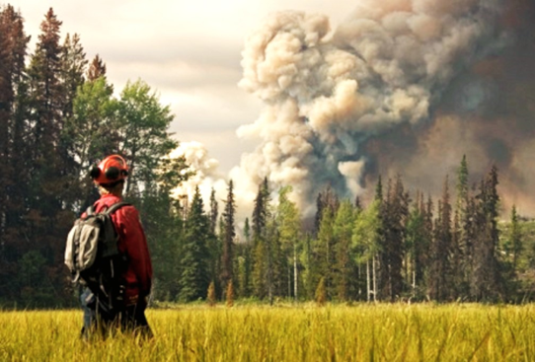
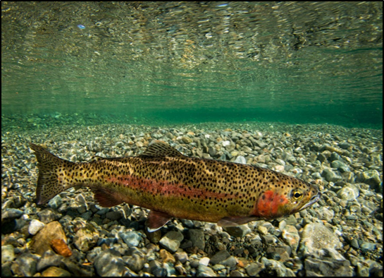
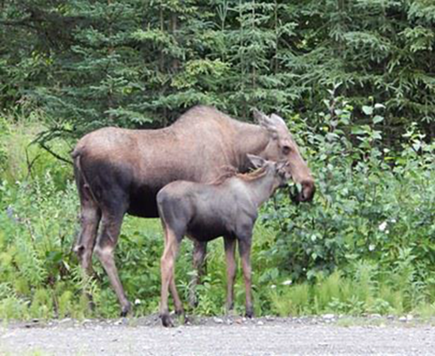
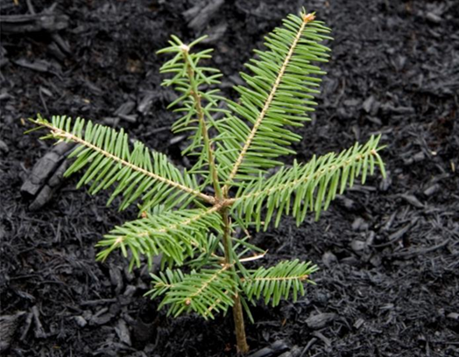

Integrated Investment Plan
Cariboo Region – October 2018

Slide 2
Cariboo Region Integrated Investment
Agenda
The Plan
The Priorities
The Process
Funding
Questions

Slide 3
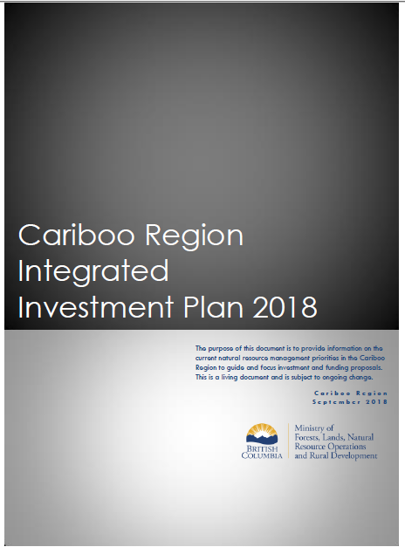
Plan Purpose and Goal
Purpose
Provide information on the current natural resource management priorities to guide and focus investment and funding in the Cariboo region.
Goal
Economic, environmental and community resilience for the Cariboo Region.

Slide 4
INTEGRATED INVESTMENT PLAN
THE PRIORITIES
Community and Economic Resiliency
Wildfire Risk Reduction
Forest Rehabilitation
Fibre Utilization
Habitat Restoration and Enhancement

Slide 5
Support Economic, Environmental and Community resilience
Direct involvement of First Nations and collaboration with First Nation for economic benefit, capacity building and respect of their rights
Partnerships with natural resource tenure holders
Commitment to implementation of BC Wildfire Hazard Abatement guidelines for any proposals that fall within identified wildfire risk reduction areas.
Preference for proposals that have had some level of initial planning and ground-truthing and that include clear outcomes.
Proposals that address multiple priorities and values on the landbase.

Slide 6
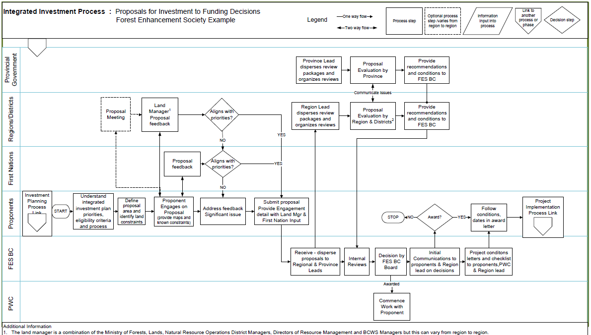
Integrated Investment Process Proposals to Decisions

Slide 7
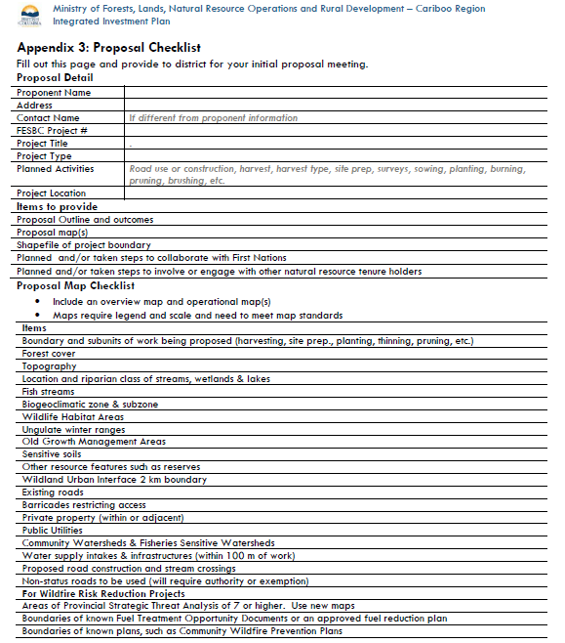
Proposal Checklist
Step 1: Define what, where and who
Solid description of what you want to do
Good map(s) of where the proposal is for
Steps of how you have and/or will be collaborating and working with others
Step 2: Work with the Natural Resource District and BCWS

Slide 8
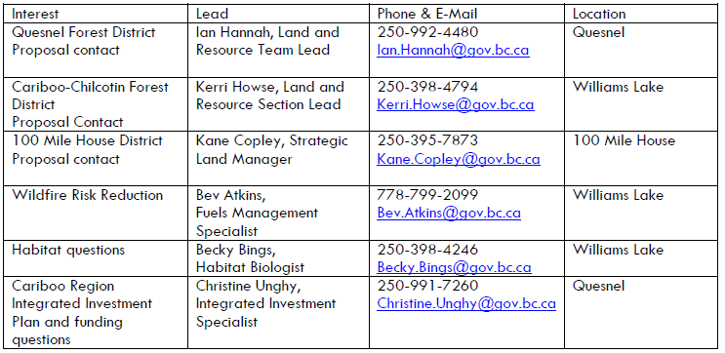
Contacts
Cariboo Region Rural Dividend Questions & other funding | Emily Colombo Regional Manager | 250-992-4442 Emily.Colombo@gov.bc.ca | Quesnel

Slide 9
Funding
Forest Enhancement Society
  Open until November 30th
  Primary contacts
    Dave Conly (DCC)
    Ray Ratz (DQU & DMH)
Community Resilience Initiative Program
  Open until December 7th
  Primary Contact: Bev Atkins
Habitat Conservation Trust Fund
  Open until November 2

